Slide 1
Classifying Bird Species in Singapore CE7454 Project
Group 14
Davide Coppola
Mitra Tajrobehkar
Shuang Wu

Slide 2
Motivation
Over 400 species on the island
Easy to spot a bird and take a picture, harder to recognize the species
Possible starting point for a future application

Slide 3


Data Acquisition
Website for enthusiasts
Almost guaranteed label accuracy
Development of web scraper from scratch
Well-know photo hosting website
More uncertainty on the labels
Combination of Flickr API and image downloader found on a Git project
Queries using scientific name to increase chance of correct label
Tools: Python3, Requests, BeautifulSoup

Slide 4
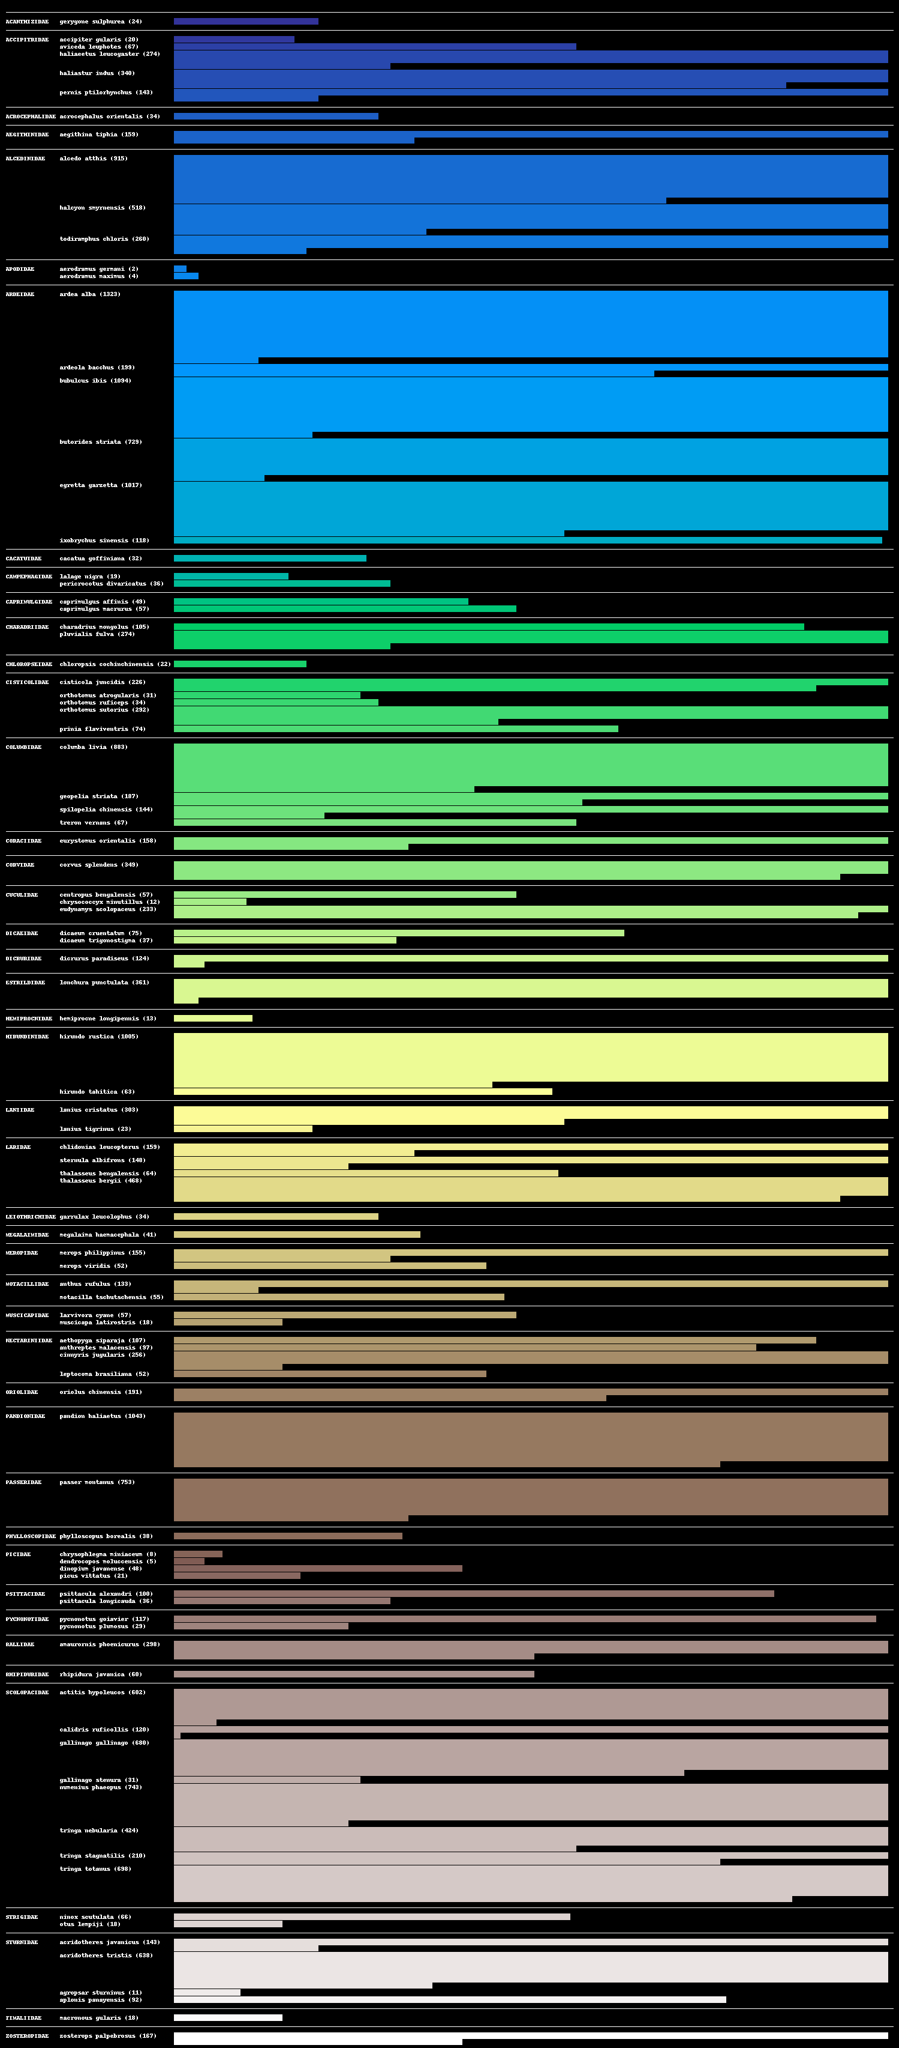
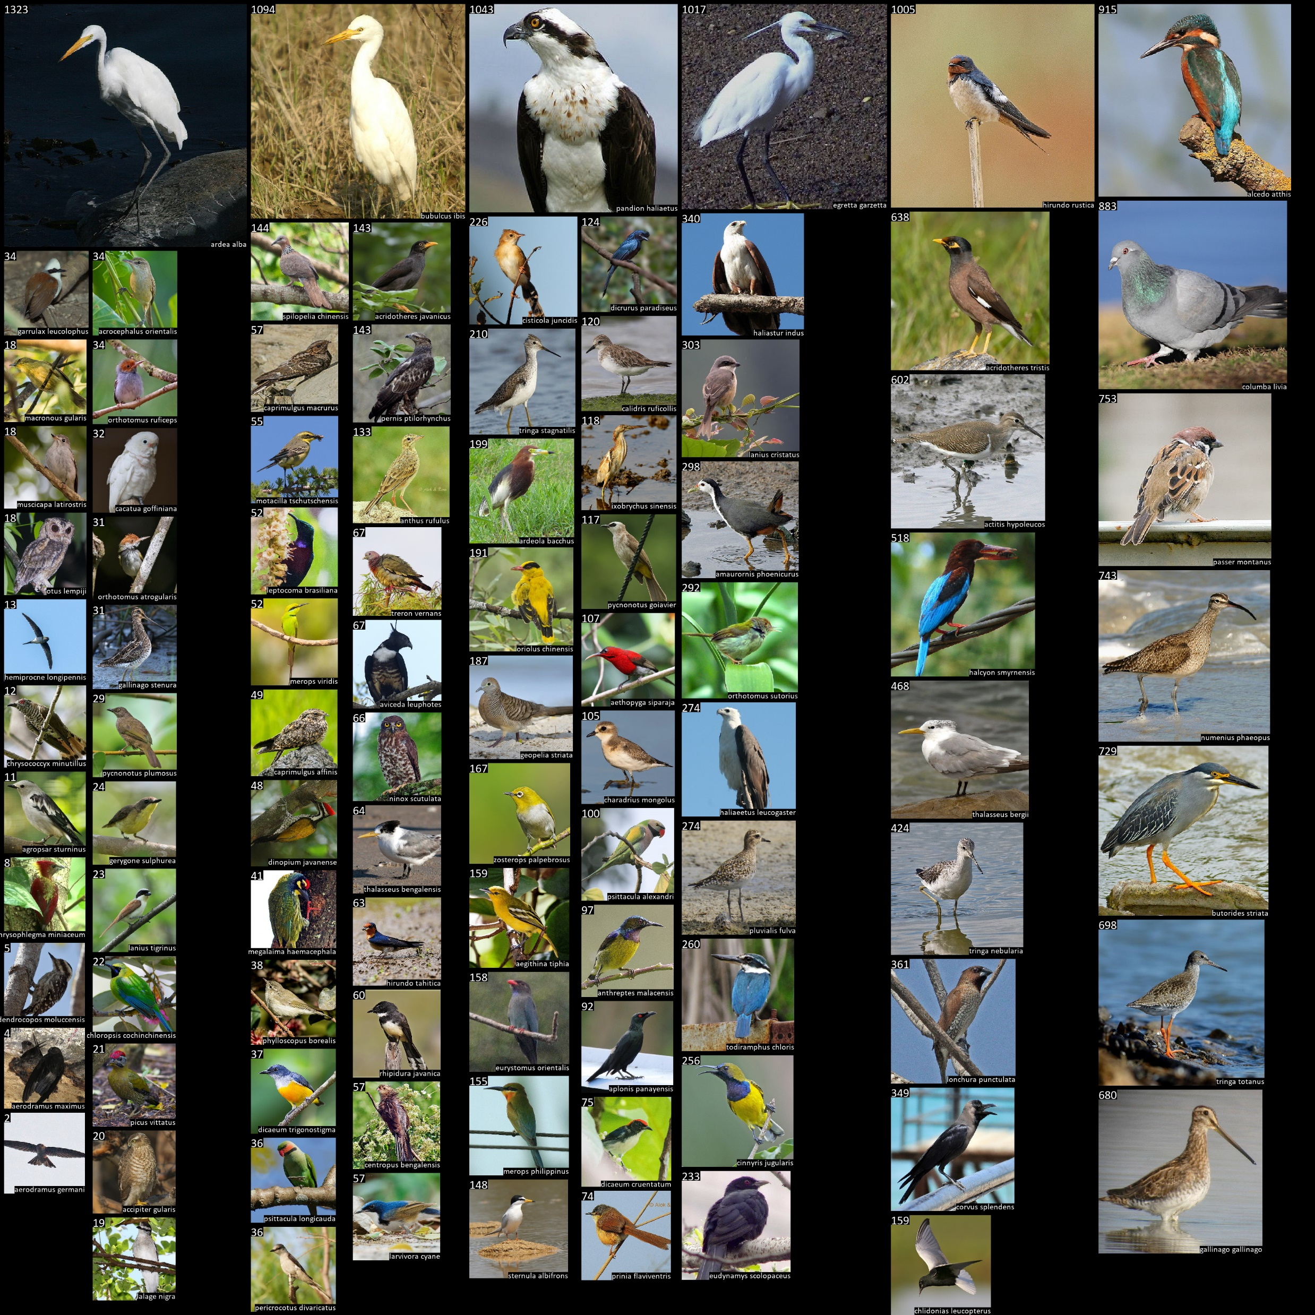
Data Exploration + Visualization

Slide 5

Data Validation

Slide 6
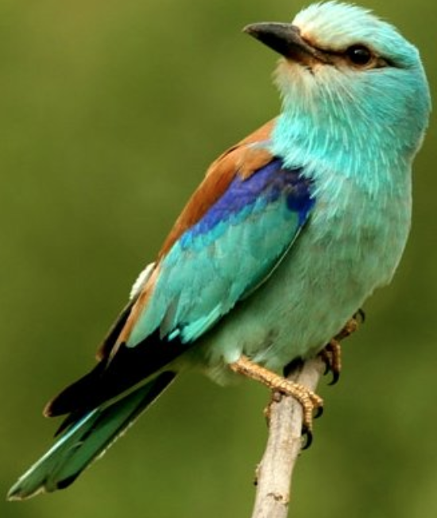
Classification
✔
# Family
Accipitradiae
Ardeidae
Laniidae
Corvidae
…
# Species
butorides striata
garrulax leucolophus
…
✔

Slide 7
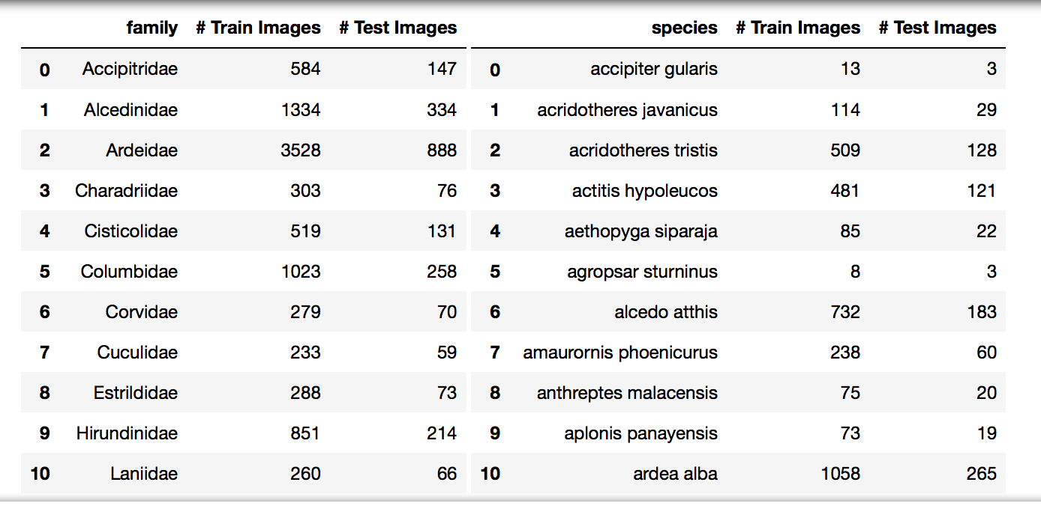
Experiment Setup

Slide 8
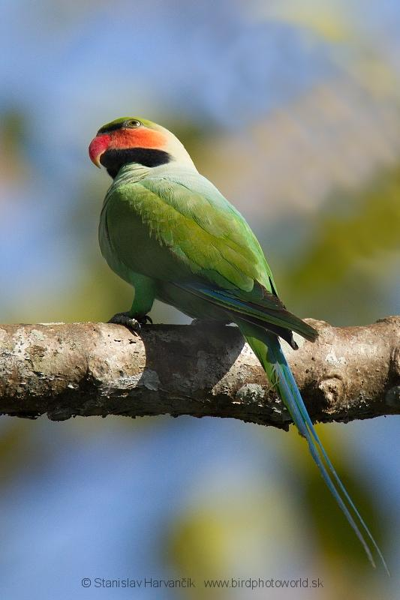
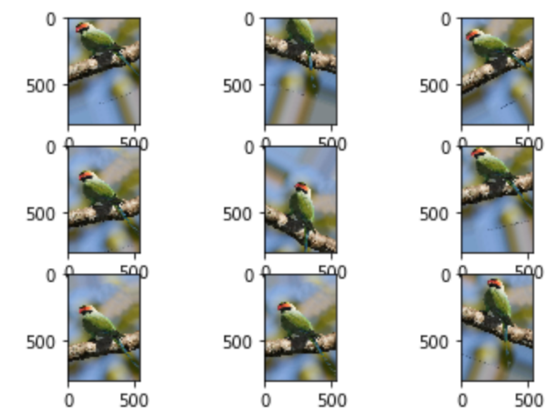
Data Preprocessing and Augmentation
Preprocessing using Adaptive Histogram Equalization
Define functions for image augmentation – Horizontal flipping, shifting etc.

Slide 9
Classification- Proposed method
Architectures
Resnet50
VGG16
Loss function
Softmax cross entropy loss
Triplet loss
Evaluation
F1-Score
Confusion Matrix

Slide 10
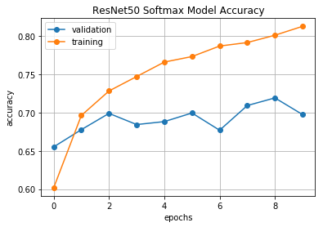
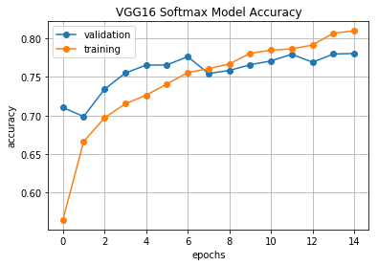
Softmax Classifier Training
ResNet50 softmax model accuracy
VGG16 softmax model accuracy
Architecture | Training Acc. | Training loss | Validation Acc. | Validation loss
ResNet50 | 0.81 | 0.59 | 0.70 | 1.24
VGG 16 | 0.81 | 0.60 | 0.78 | 0.94

Slide 11
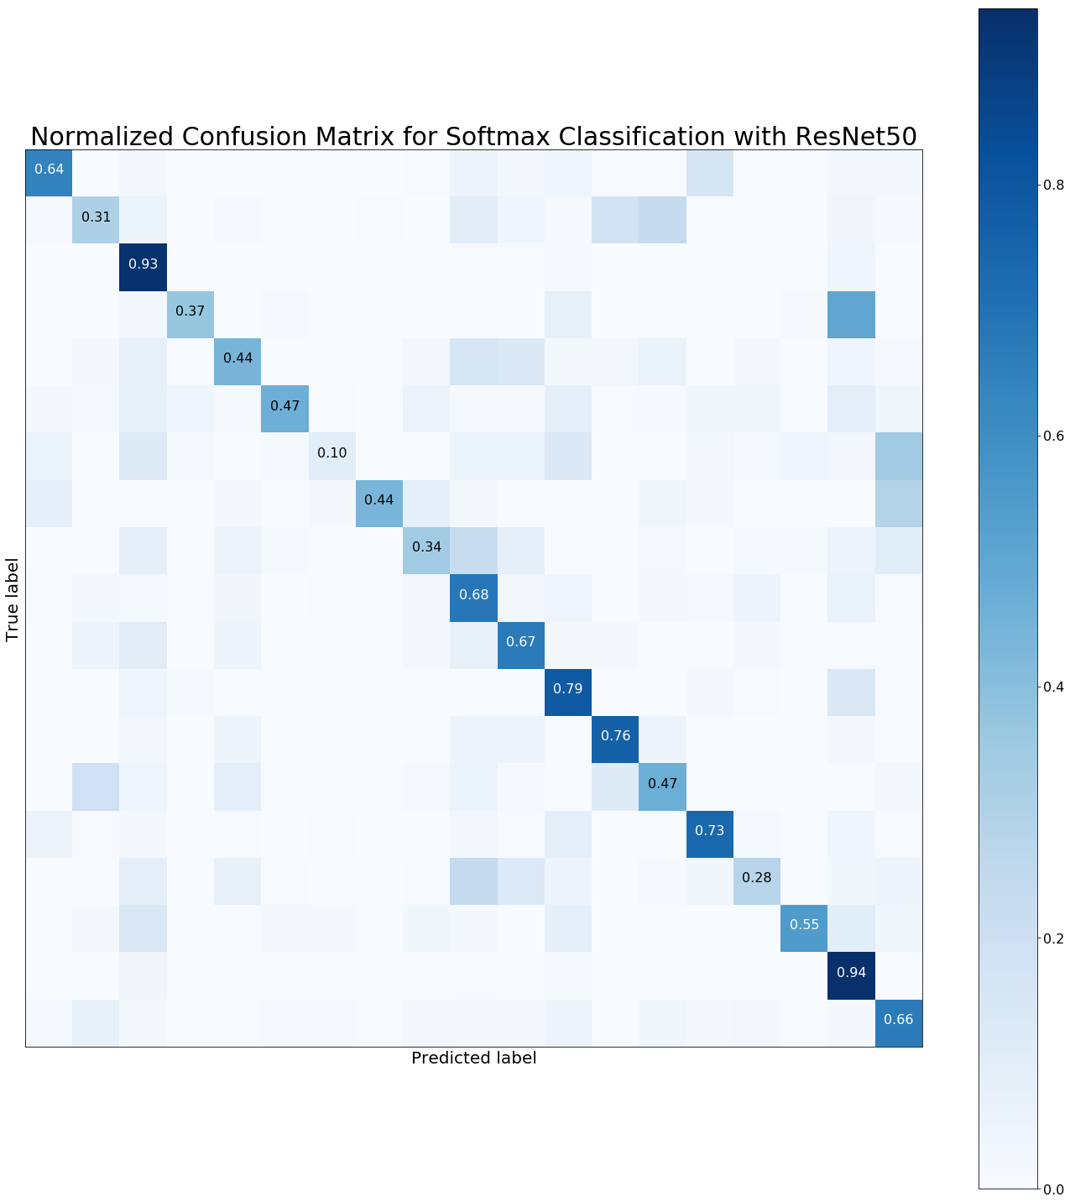
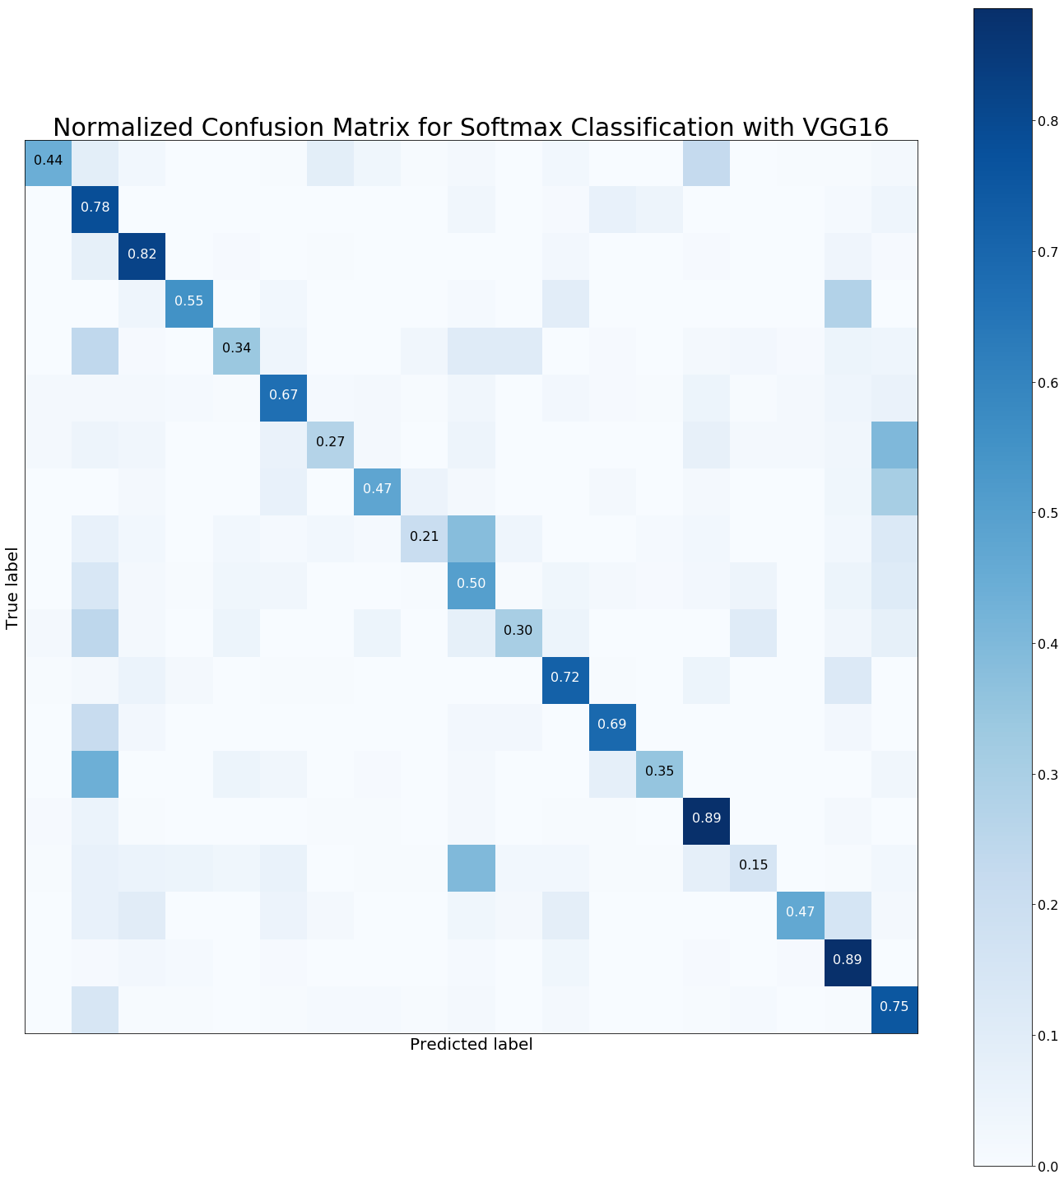

Slide 12
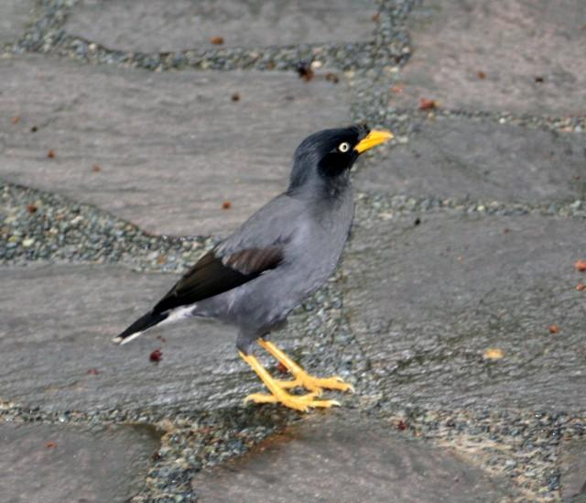
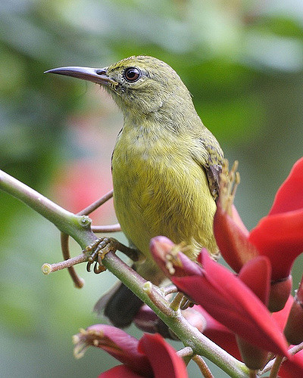
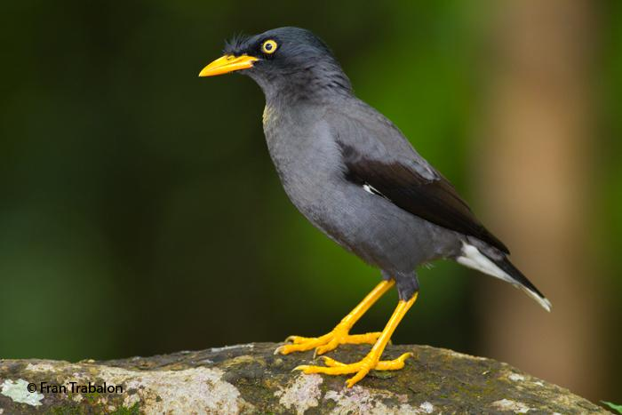
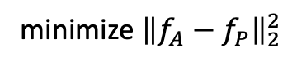


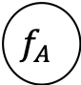
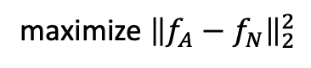
Triplet Loss Classifier
Sample triplets
Anchor
Positive
Negative
CNN
Metric learning => learn embedding into feature space
k-NN classifier on this feature space
$$f_{P}$$
$$f_{A}$$
$$f_{N}$$
minimize ${\left\|f_{A}−f_{P}\right\|}_{2}^{2}$
maximize ${\left\|f_{A}−f_{N}\right\|}_{2}^{2}$

Slide 13
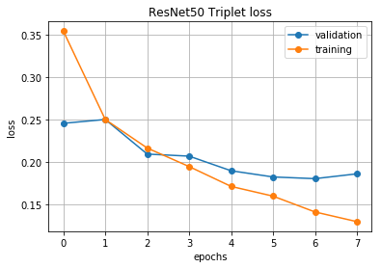
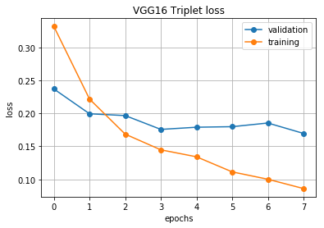
Triplet Loss Classifier Training
Architecture | Training loss | Validation loss
ResNet50 | 0.13 | 0.18
VGG 16 | 0.09 | 0.17

Slide 14
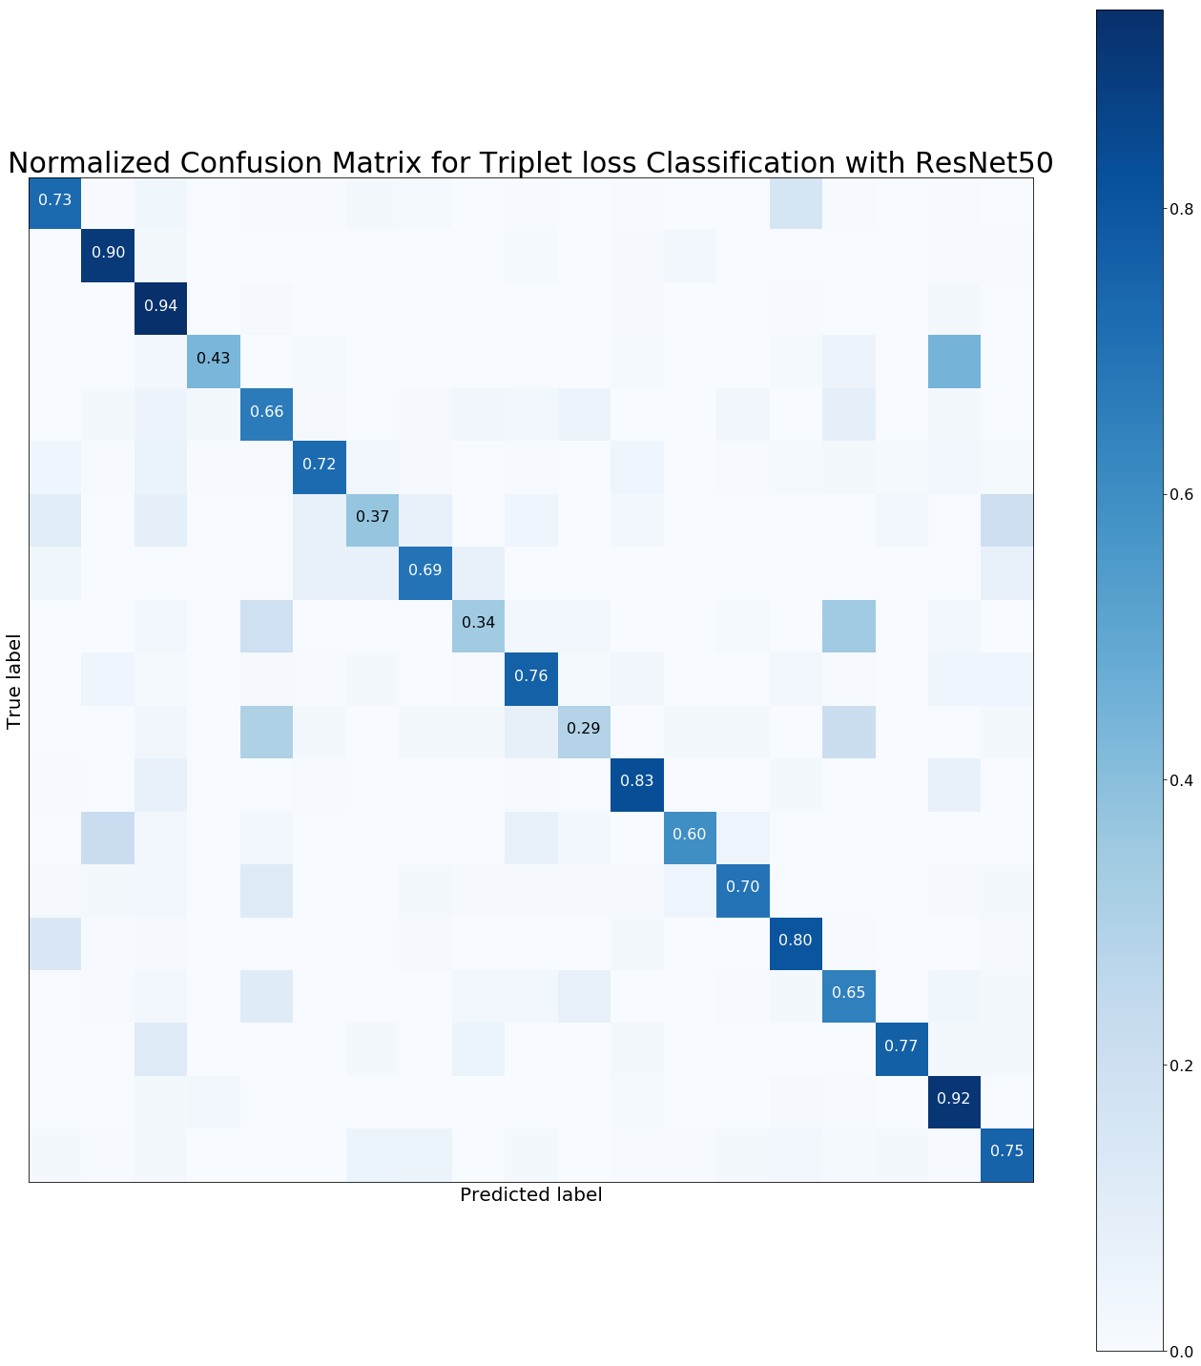
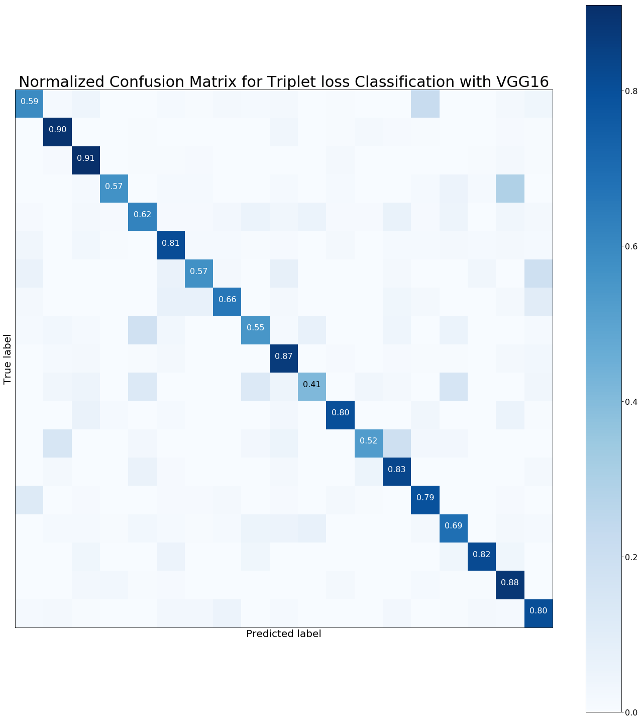

Slide 15
Overall Comparison
Triplet loss classifier superior performance over softmax classifier
Pretrained ResNet50 or VGG16 yields similar performance
Another key advantage of triplet loss classifier: generalize to new classes without the need for retraining
Architecture | Precision | Recall | F1-Score
ResNet50 Softmax | 0.71 | 0.69 | 0.67
VGG16 Softmax | 0.70 | 0.68 | 0.67
ResNet50 Triplet | 0.80 | 0.80 | 0.80
VGG16 Triplet | 0.81 | 0.81 | 0.81

Slide 16
Triplet loss classifier: Generalizing to new classes
Originally trained on 19 bird families (consisting at least 200 samples per family)
Increase to 43 bird families: 24 new classes (< 200 samples per family)
We can re-use learnt embedding model to map onto feature space directly and perform k-NN classification
No need to retrain
Configuration | Precision | Recall | F1-Score
Original | 0.80 | 0.80 | 0.80
24 new classes | 0.70 | 0.72 | 0.70

Slide 17
Github!
MitraTj/ntu_CE7454_ClassifyingBirdSpecies

Slide 18
Thank you for your attention!
Group 14

